Slide 1


Image classifier using the Fashion MNIST dataset to categorize clothing
Caption
1-Ishika Sharma. 202401100300129 CSEAI B
2-Honey Priya 202401100300127 CSEAI B
3-Divyansh Singh 202401100300105 CSEAI B
4-Briteshwar Kumar 202401100300091 CSEAI B
~Submitted to Shivansh sir

Slide 2
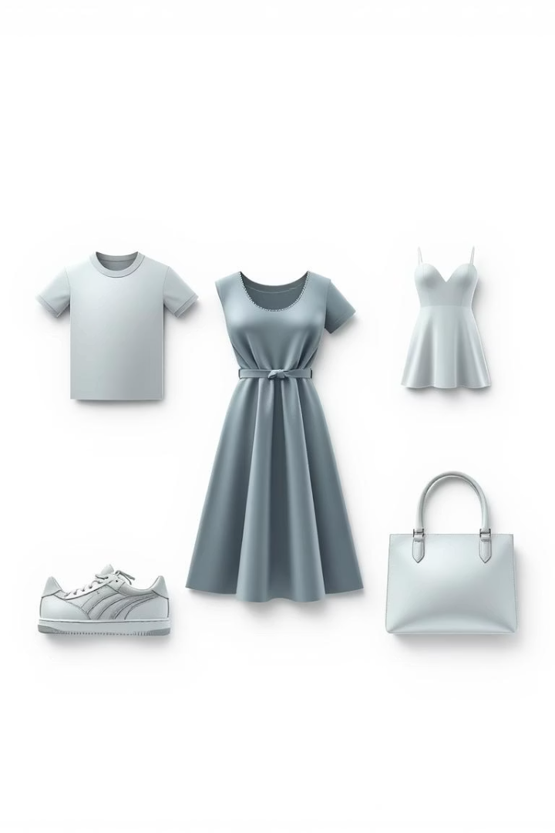
Introduction
Fashion Item Classification Using Fashion MNIST
This project aims to build an image classifier to categorize clothing items from the Fashion MNIST dataset. We'll explore the model design, training process, and visualize performance using a confusion matrix.

Slide 3
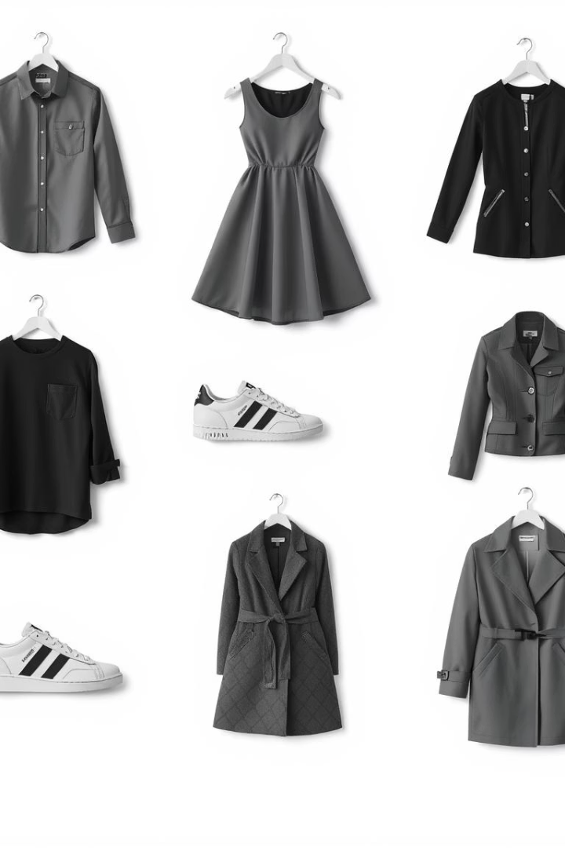
Understanding Fashion MNIST Dataset
Dataset Composition
70,000 grayscale images of 28x28 pixels with 10 clothing categories.
Categories Included
T-shirt/top
Trouser
Pullover
Dress
Coat
Sandal
Shirt
Sneaker
Bag
Ankle boot

Slide 4
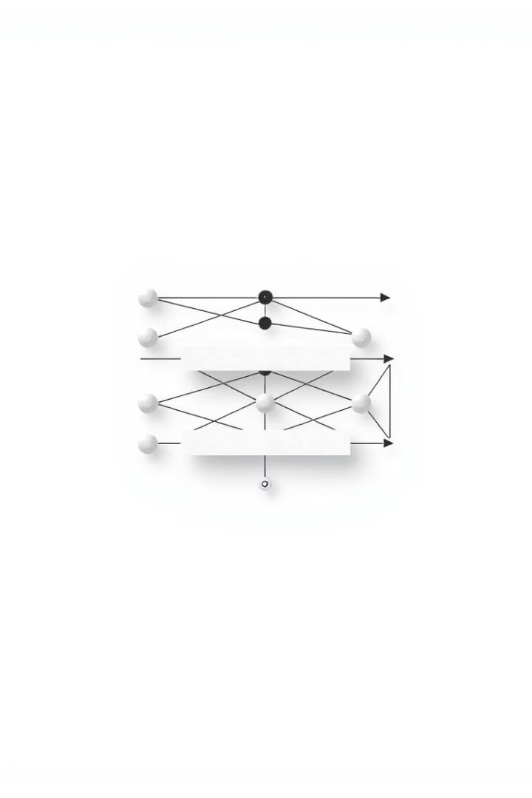
Model Architecture Overview
1
Input Layer
Processes 28x28 grayscale images.
2
Convolutional Layers
Extract spatial features with filters.
3
Pooling Layers
Reduce dimensionality and computation.
4
Dense Layers
Perform classification based on learned features.

Slide 5
Training and Optimization
Data Preprocessing
Loss Function
Optimizer
Epochs & Batch Size
Normalize images to improve model convergence.
Use categorical cross-entropy for multi-class classification.
Adam optimizer for efficient gradient updates.
Adjust to balance training time and accuracy.

Slide 6
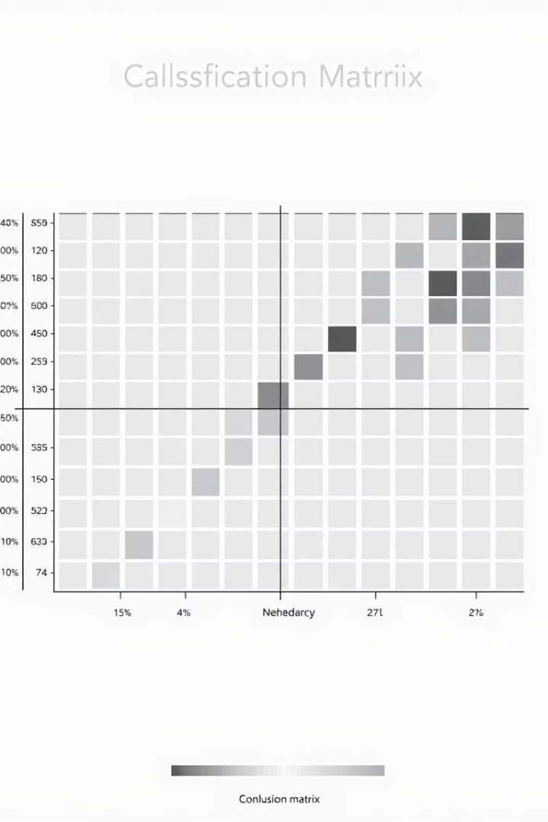



Evaluating Model Performance
True Positives
Correctly identified categories.
False Positives
Incorrectly predicted categories.
False Negatives
Missed correct categories.

Slide 7
Common Misclassifications in Fashion MNIST
Trouser vs. Dress
Shirt vs. T-shirt
Sneaker vs. Ankle boot
Similar silhouette causes confusion.
Overlap in collar styles creates errors.
Visual similarity in shapes and colors.

Slide 8
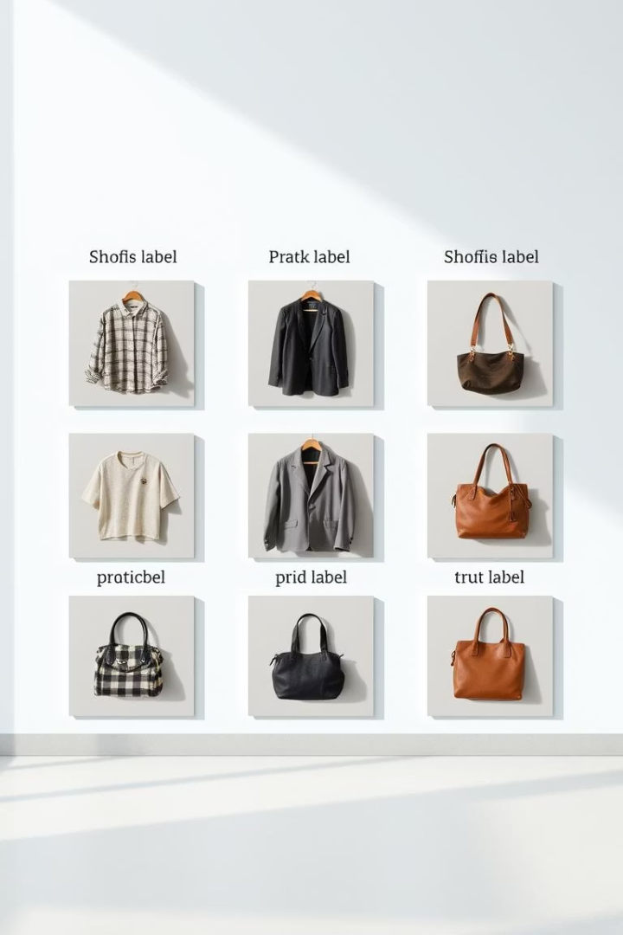
Visualizing Prediction Examples
Correct Predictions
Incorrect Predictions
Model confidently classifies clear images.
Uncertain cases with overlapping features.
Insights
Helps refine model and data augmentation strategies.

Slide 9

Key Takeaways and Next Steps
Dataset Quality
High-quality labeled data is crucial.
Model Choice
CNNs excel at image classification tasks.
Performance Metrics
Use confusion matrices for detailed insights.
Future Work
Explore data augmentation and advanced architectures.

